Slide 1

Control Logic Design
Md. Shaoran Sayem
Microprogram, flow-chart, state-diagram

Slide 2
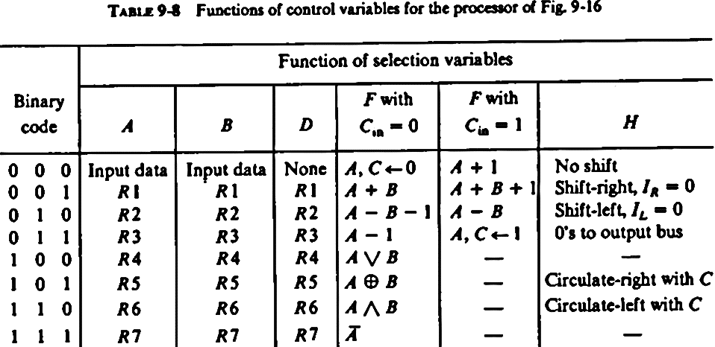
ALU Function Selection Table
S

Slide 3
Question_12
S
Transfer Function
Compliment of B, y
Full Value, only Sine
A-B
Clear
Z

Slide 4
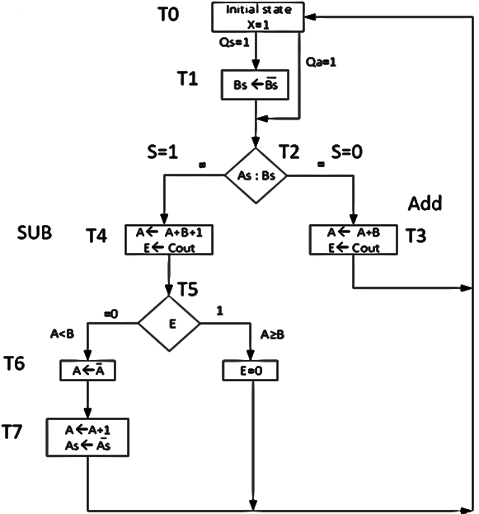
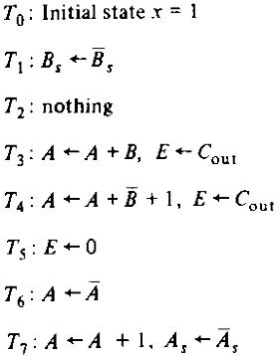
Flowchart and state diagram for sign magnitude addition and subtraction operation

Slide 5
Sequence of Register Transfers
S
ALU Table
Not Transfer Function

Slide 6
Microprogram for Control Memory_15
S
MUX
Binary microprogram for control memory

Slide 7
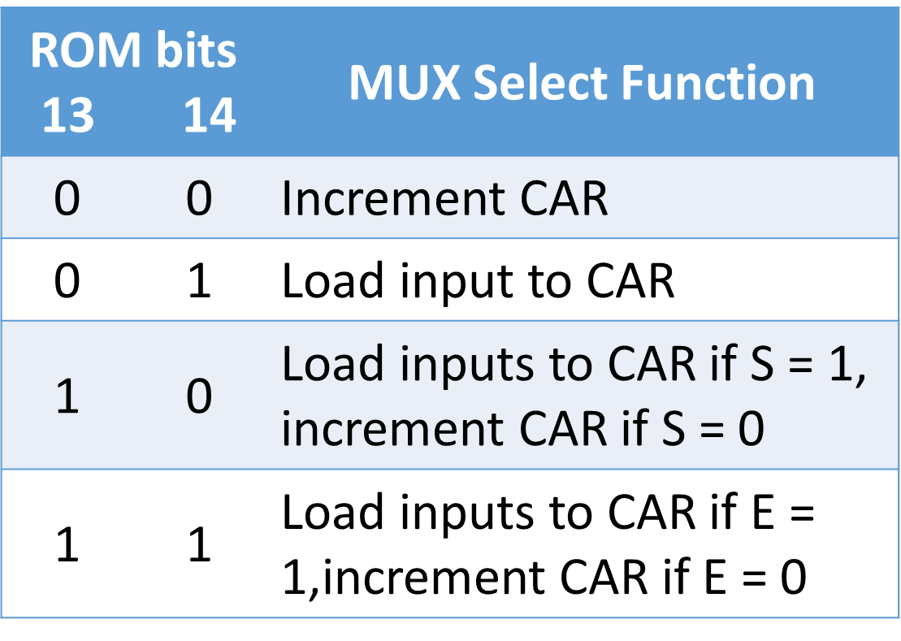
MUX Select Function (Hardware Configuration)
S

Slide 8

Flow chart for counting the number of 1’s in register R1
R1 (Binary) |  | 0 |  | 1 |  | 0 |  | C | R2 (D)
0 | 0 | 1 | 1 | 0 | 1 | 0 | 1 | 0 | 0
0 | 0 | 0 | 1 | 1 | 0 | 1 | 0 | 1 | 1
0 | 0 | 0 | 0 | 1 | 1 | 0 | 1 | 0 | 1
0 | 0 | 0 | 0 | 0 | 1 | 1 | 0 | 1 | 2
0 | 0 | 0 | 0 | 0 | 0 | 1 | 1 | 0 | 2
0 | 0 | 0 | 0 | 0 | 0 | 0 | 1 | 1 | 3
0 | 0 | 0 | 0 | 0 | 0 | 0 | 0 | 1 | 4
+
Count the number of 1’s in a register= All 0 Count the number of 0’s in a register= All 1

Slide 9
Symbolic micro-program

